Slide 1
Accessing HPC System
Notes:
t

Slide 2


Agenda
Connecting HPC..
Connecting HPC through Terminal
Connecting HPC through HPCPortal
Transferring Files to HPC ?

Slide 3
Available login nodes

Slide 4
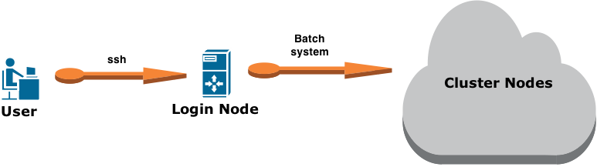
Available Login Nodes in NUS HPC
Hostname
atlas6-c01
atlas7-c10
atlas8-c01
atlas9-c01
gold-c01

Slide 5
Connecting HPC Using MobaXterm

Slide 6
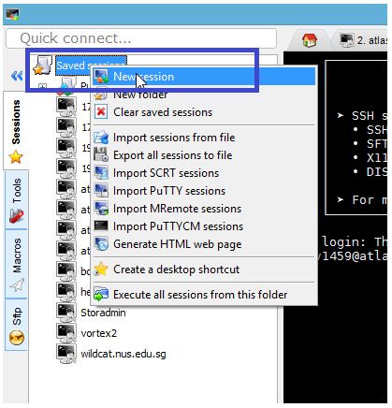
Connecting from a Windows system:-
Mobaxterm : MobaXterm is an enhanced terminal for Windows with an X11 server.
Download Link http://mobaxterm.mobatek.net/MobaXterm_Setup_9.3.msi
Step-1: Click on New session

Slide 7
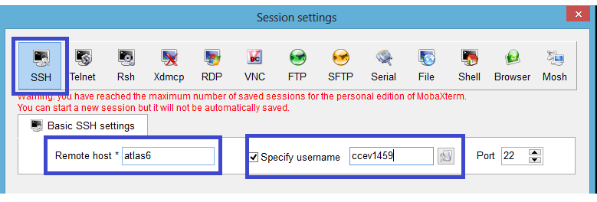
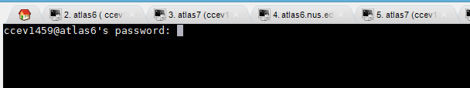
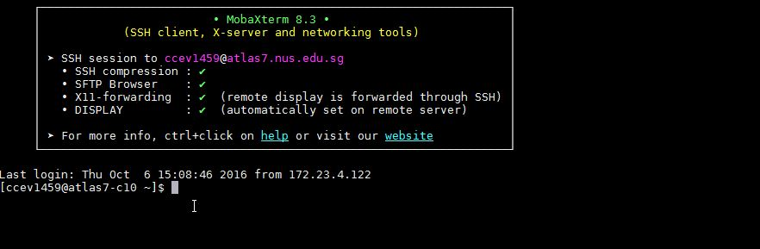
Step-2: Input the login node hostname and user-ID details as shown in below figure.
Step-3: When prompted for password, enter the password and press enter key.
Step-4: Welcome to Login Node.

Slide 8
Connecting HPC Portal

Slide 9
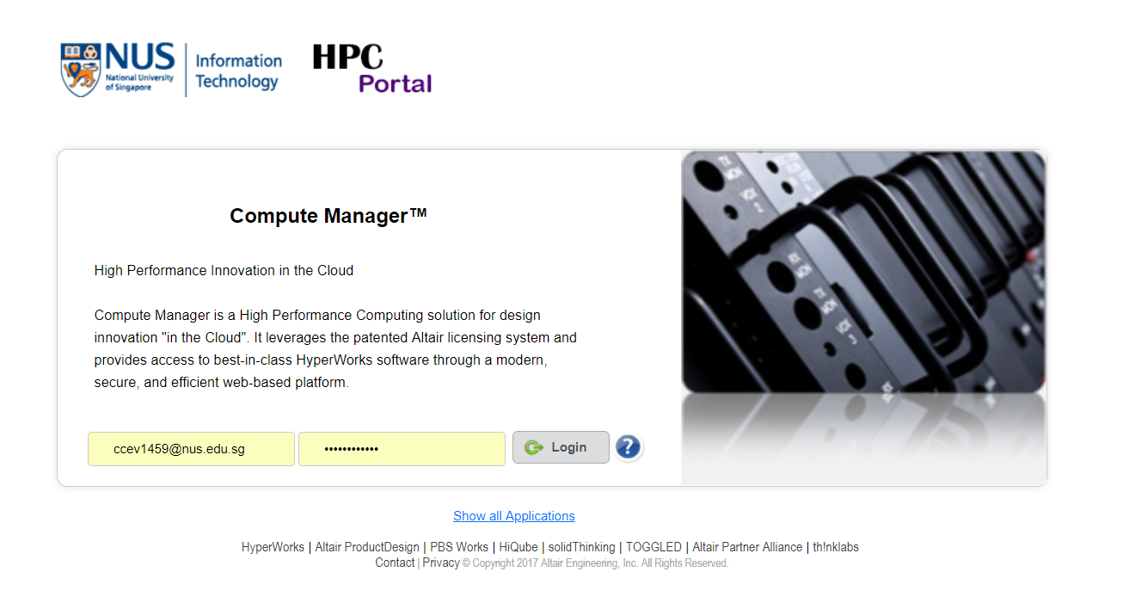
Open https://hpcportal.nus.edu.sg on your browser

Slide 10
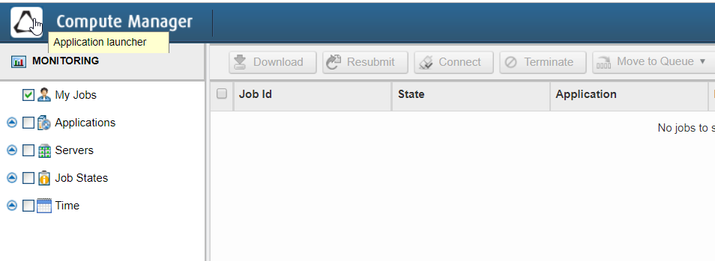
Click on the application launcher

Slide 11
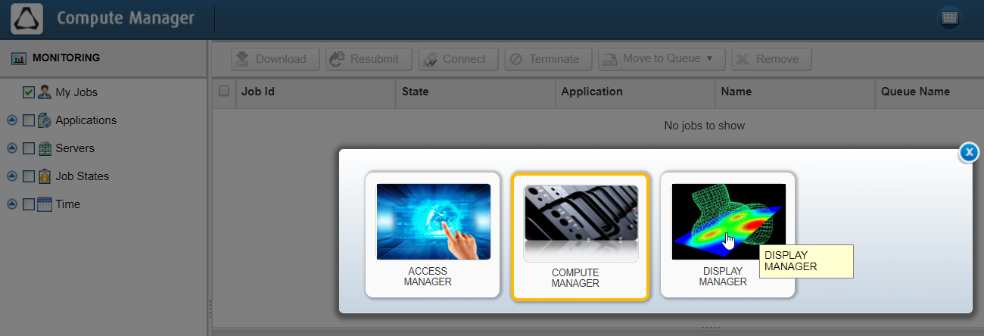
Click and open Display Manager

Slide 12
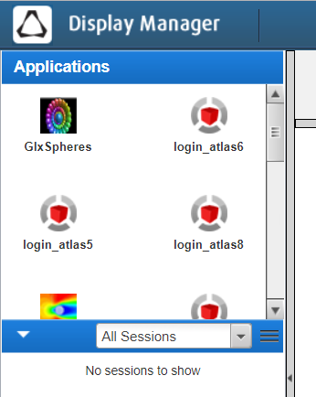
On the left hand menu you can find all the login nodes and application launchers.
Login Nodes
Login_atlas5
Login_atlas6
Login_atlas7
Login_atlas8
Login_gold
Application Launchers
GlxSpheres
Fluent
workbench
vmd
Abaqus
CFX
Gaussview6
Matlab

Slide 13
Transferring Files to HPC ?

Slide 14
Working Directories Information
Directories | Feature | Disk Quota | Backup | Description
/home/svu/$USERID | Global | 20 GB | Snapshot | Home Directory. U:drive on your PC.
/hpctmp | Local on All Atlas cluster | 500 GB | No | Working Directory. Files older than 60 days are purged automatically
/hpctmp2 | Local on All Atlas cluster | 500 GB | No | Working Directory. Files older than 60 days are purged automatically
Note: Type “hpc s” to check your disk quota for your home directory.

Slide 15
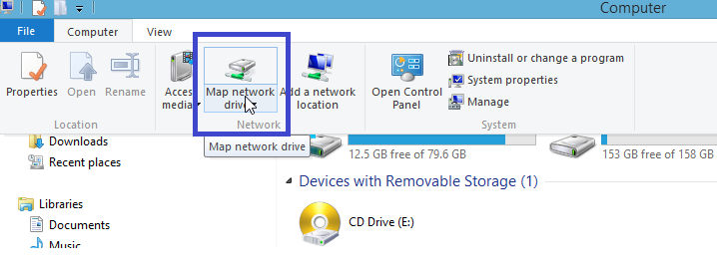
Mount user hpc home directory on windows system:
Mounting user Home Directory on a windows system Example: To mount(/home/svu/$userid)
Step-1: Click on “Map Network Drive”, from My computer window.

Slide 16
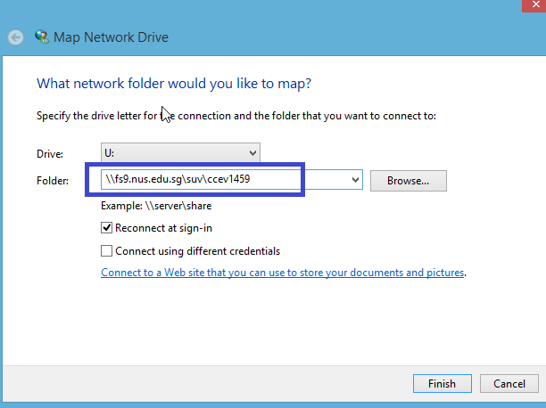
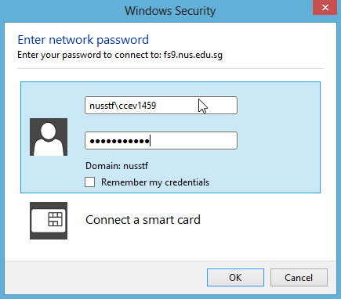
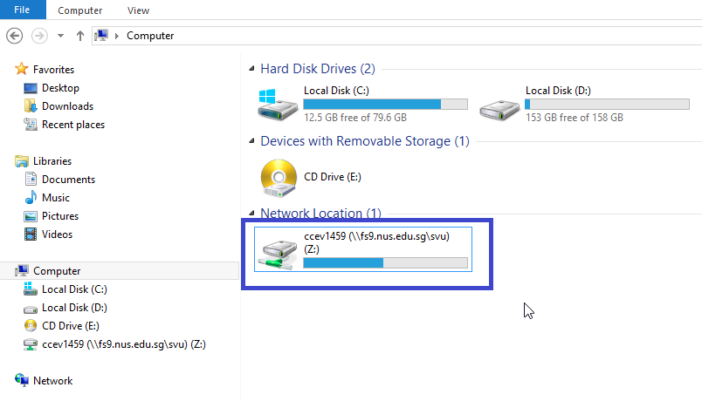
Step-2: Input the server details in the Folder section as “\\fs9.nus.edu.sg\svu\” followed by your userid.
Step-3: Provide the NUS credential as below. The user home directory will be mounted.

Slide 17

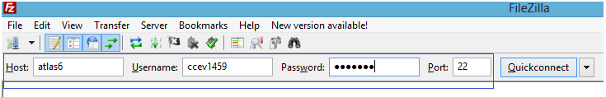
Transfer files using FileZilla:
Download Links
Windows https://filezilla-project.org/download.php?type=client
Mac user https://filezilla-project.org/download.php?show_all=1
Step-1: Open FileZilla

Slide 18
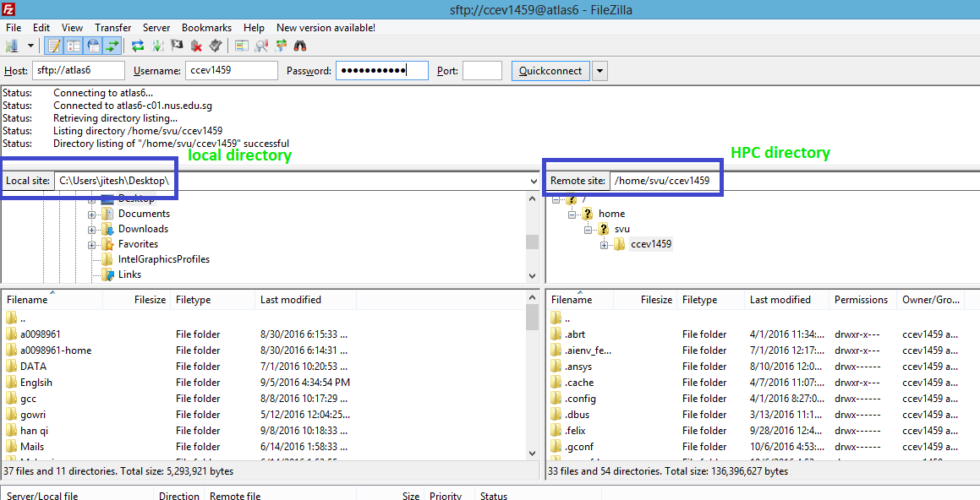
Step-2: For transferring the files or folders simply drag & drop files from local directory to HPC directory
All transfers via Sftp is done in “BINARY” format. No ASCII file transfers like in ftp.
Users need to convert DOS text files to Unix text files using the “dos2unix” command in the HPC command line.

Slide 19
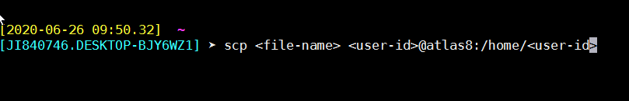
Unix based user:
Can transfer files using scp command

Slide 20
Thank you

